Slide 1
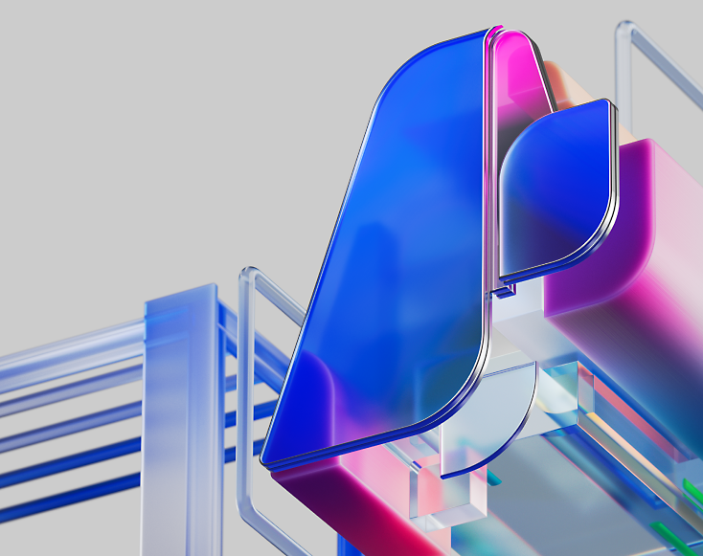
MCP
(Model Context Protocol)

Slide 2
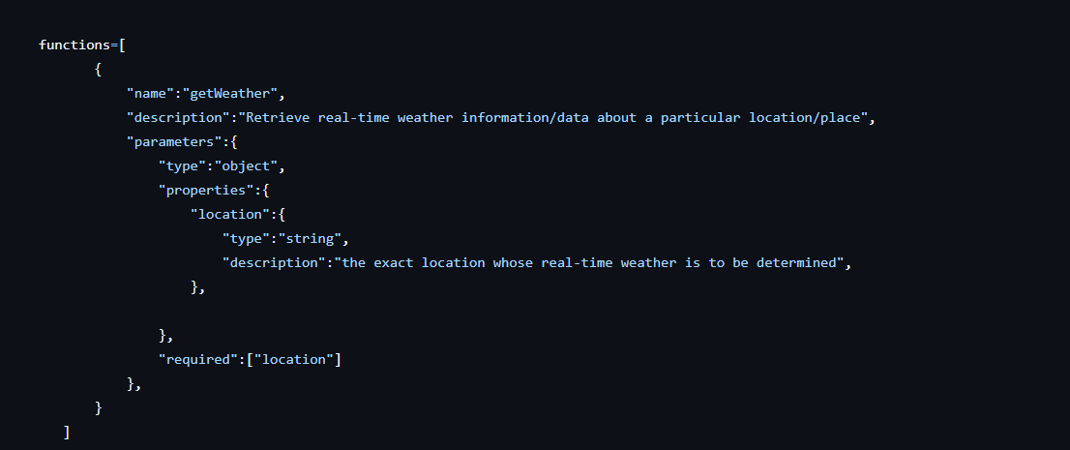
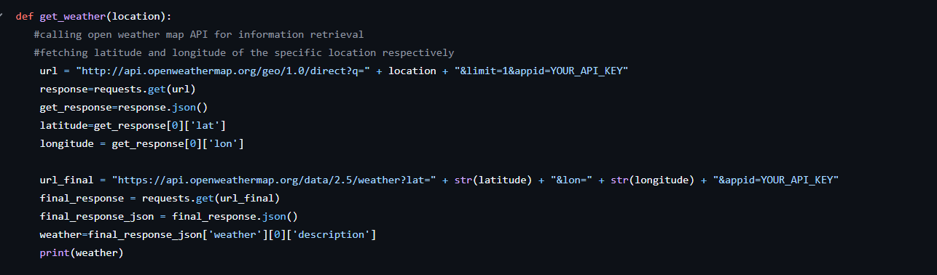
Mr. Robin is building an Agent that could perform real-time searches – one of them being – “Fetching weather data from a real-time API”

Slide 3
And suddenly all hell breaks loose……
Mr. Robin learns that overnight the API methods changed – query params, payload structure etc.
This essentially means his AI Agent is now good for nothing! THIS IS NOT GOOD ☹
The Solution is – MCP

Slide 4
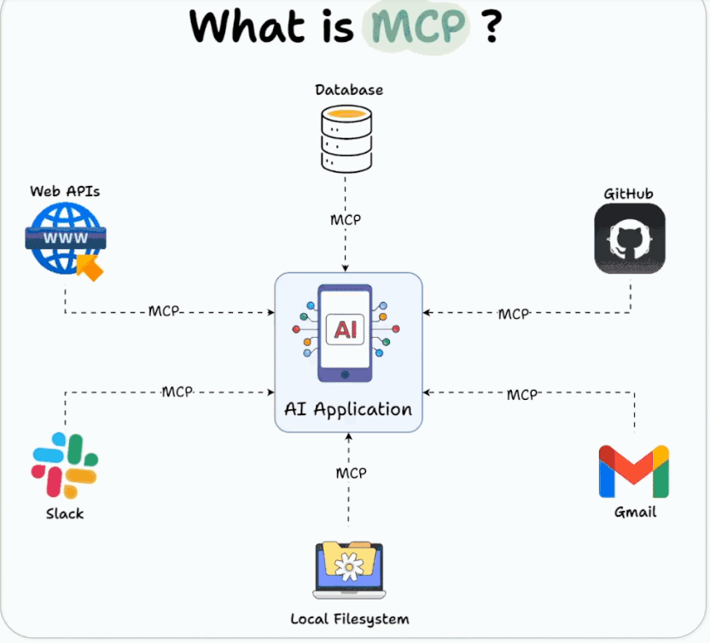
MCP has the potential to function as a universal interface, think of it as the virtual / software version of USB-C for AI. Enabling seamless, secure and scalable data exchange between LLMs/AI Agents and external resources.
MCP uses a client-server architecture where MCP hosts (AI applications) communicate with MCP servers (data/tool providers). Developers can use MCP to build reusable, modular connectors, with pre-built servers available for popular platforms, creating a community-driven ecosystem.

Slide 5
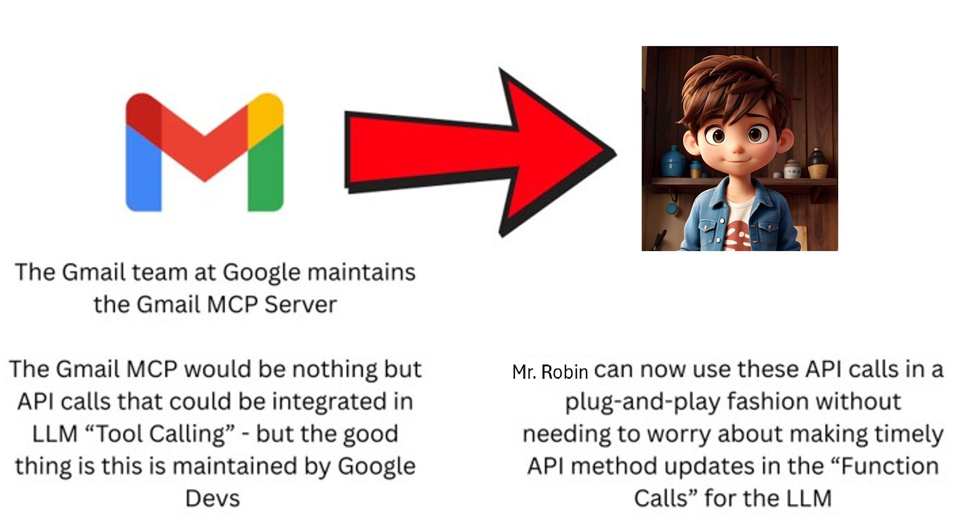
Let's try to break things in a simpler fashion!
These MCP servers will be maintained by a group of people (there’s also a large open-source community driving this forward with MCP servers already built for GitHub, Gmail, Azure etc.)
These MCP servers can be exposed over the internet (users can connect remotely) or even be run as Docker Images locally for data privacy concerns (GitHub MCP Server is a Docker Image)
Remote MCP servers - MCP clients connect to MCP servers over the internet, establishing a connection using HTTP and server-sent events (SSE), and authorizing the MCP client access to resources on the user's account using OAuth.
Local MCP servers MCP clients connect to MCP servers on the same machine, using standard input/output as a local transport method.

Slide 6
But all that Glitters is not Gold……
MCP Servers are quite difficult to implement. These are , what I feel, not that developer friendly and are quite a pain to implement right now with all the toolsets.
This would mean more work for these “Gmail” or “GitHub” MCP devs but less work for us than before ☺
The thought behind this is very optimistic but it still has quite a long way to go.

Slide 7
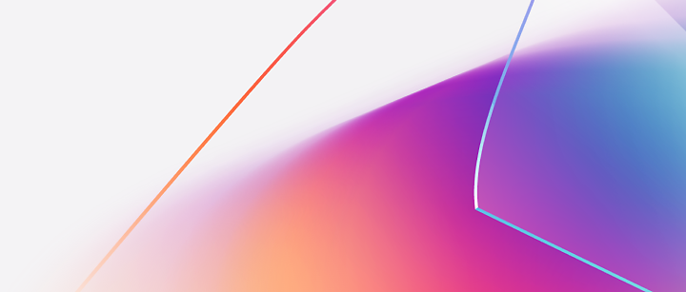
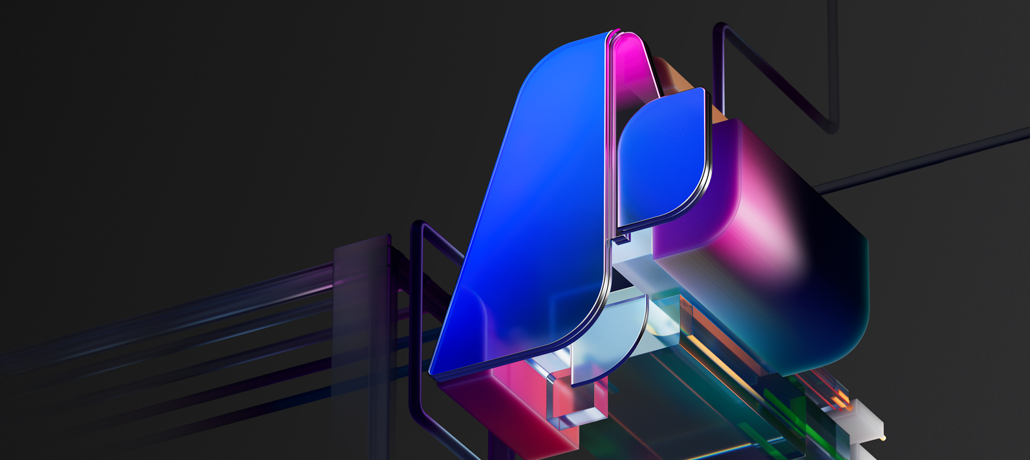
MCP
(a Detailed Breakdown)

Slide 8
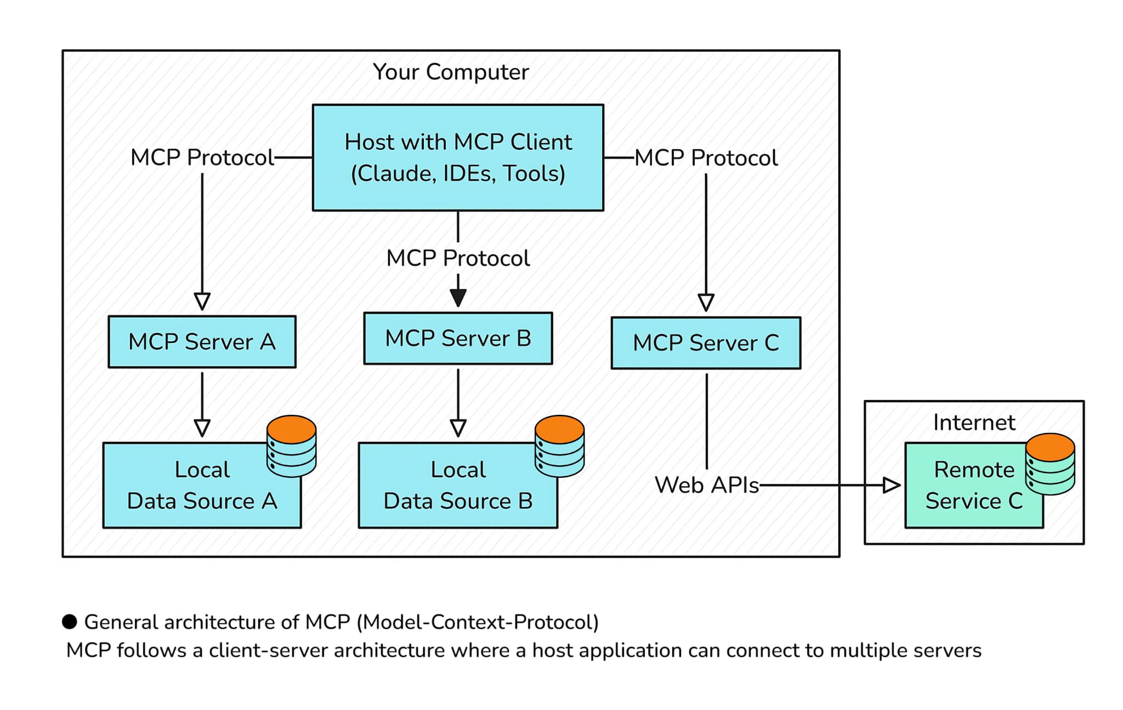
MCP – General Architecture
1) MCP Hosts: Programs like Claude Desktop, IDEs, or AI tools that want to access data through MCP
2)MCP Clients: Protocol clients that maintain 1:1 connections with servers
MCP Servers: Lightweight programs that each expose specific capabilities through the standardized Model Context Protocol
3) Local Data Sources: Your computer’s files, databases, and services that MCP servers can securely access
4) Remote Services: External systems available over the internet (e.g., through APIs) that MCP servers can connect to
At its core, MCP follows a client-server architecture where a host application can connect to multiple servers

Slide 9
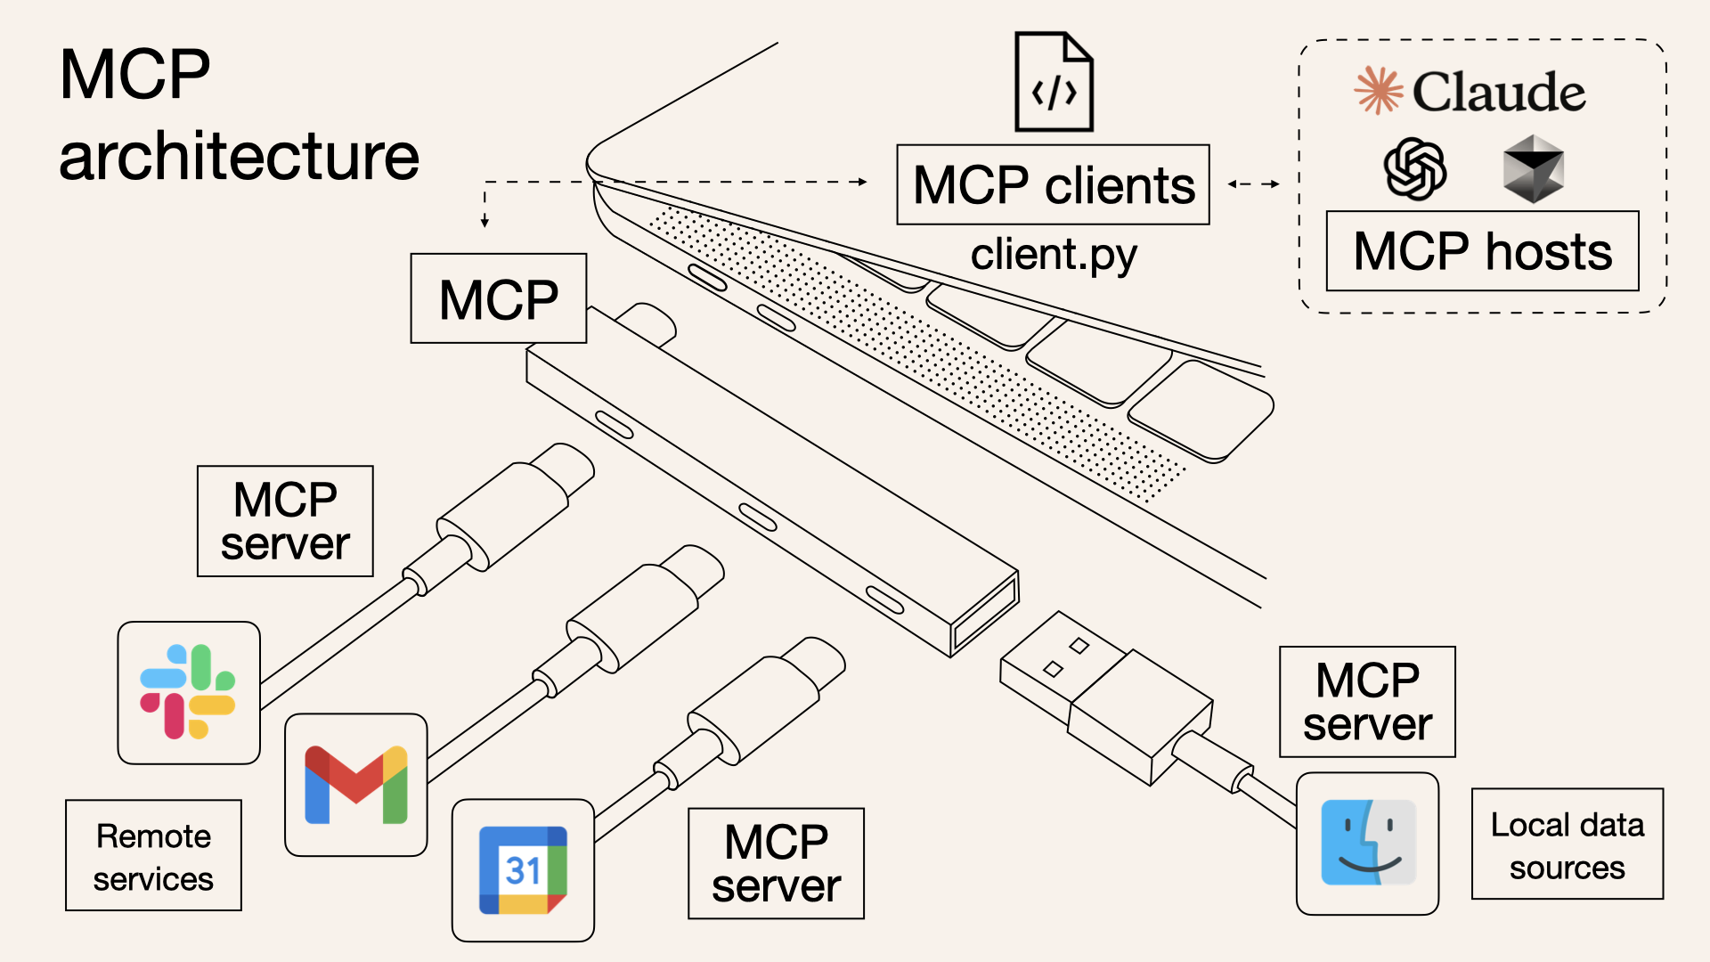
And then it looks something like……
This is EASY!
This is TOUGH!
You would focus on consuming the MCP server information if you are acting as the customer for those enterprises.
MCP Server – this is something you would develop if you are in the Gmail team, Slack Team or even part of a team that sells its API services

Slide 10

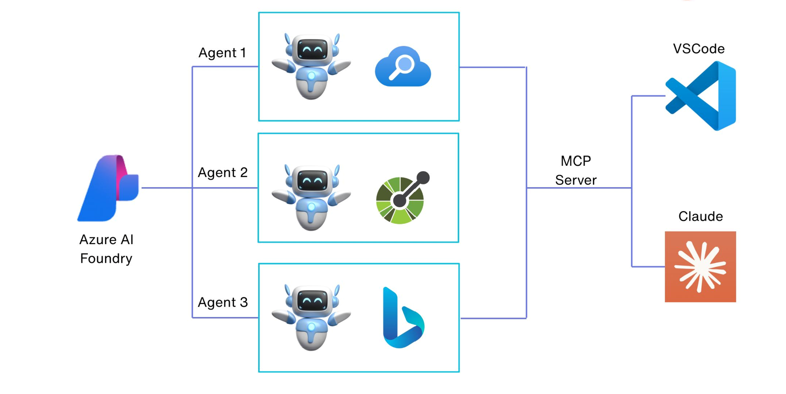
MCP with a Touch of Azure AI

